Slide 1
MCU UPDI Porting
Rocup Wan

Slide 2
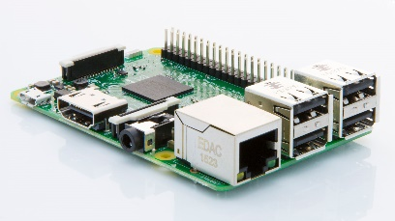
Software Framework
One of the USART need to be used to connect to UPDI
pin in the Attiny device. TX need to connect through a
4.7K ohm resistor to RX and RX connects to UPDI pin directly.
MCU
CUPDI Module
UART
RX
TX
4.7K
Attiny series
UPDI
Embedded Board

Slide 3
UPDI Introduce
UPDI（Unified Program and Debug Interface）：
Features
– External programming through UPDI 1-wire (1W) interface
1-wire UART-based half duplex interface using the RESET pin for data reception and transmission
– Uses the RESET pin of the device for programming
No GPIO pins occupied during operation
Debugging
– Memory mapped access to device address space (NVM, RAM, I/O)
The UPDI supports programming of nonvolatile memory (NVM) space;
FLASH, EEPROM, fuses, lockbits, and the user row.
In addition, the UPDI can access the entire I/O and data space of the device.
– Clocking of UPDI PHY is done by an internal oscillator
Communication using a fixed frame format,
and automatic baud rate detection for clock and data recovery.

Slide 4
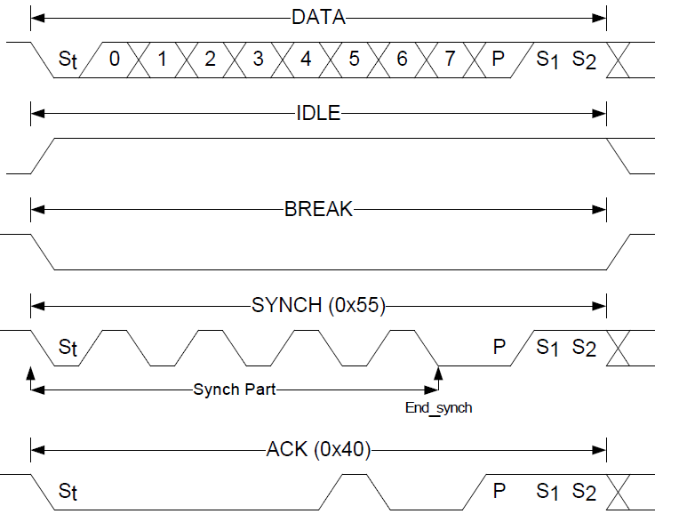
UPDI Introduce
UPDI Frame：
DATA，BREAK，IDLE，SYNCH，ACK 5 Types
Data frame consists of one Start bit (always low), eight data bits, one parity bit (even parity), and two Stop bits (always high).

Slide 5
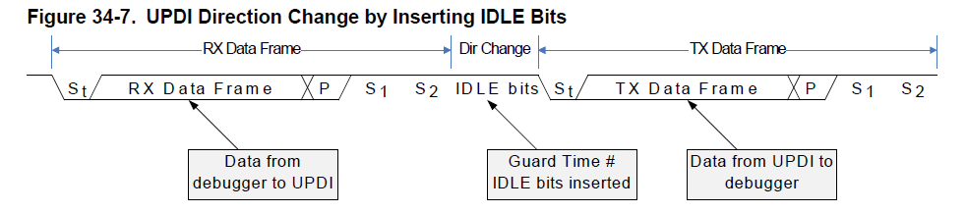
UPDI Introduce
Direction Change：
UPDI has a built-in Guard Time mechanism to relax the timing when changing direction from RX mode to TX mode.
The Guard Time is a number of IDLE bits inserted before the next Start bit is transmitted.
The number of IDLE bits can be configured through GTVAL in UPDI.CTRLA. (Default 128 clks)

Slide 6
UPDI Introduce
UPDI Instruction Set：
Direct Addressing Access：
LDS - Load Data from Data Space Using Direct Addressing
STS - Store Data to Data Space Using Direct Addressing
Indirect Addressing Access:
LD - Load Data from Data Space Using Indirect Addressing
ST - Store Data from Data Space Using Indirect Addressing
Control and Status Register Space Access:
LCDS - Load Data from Control and Status Register Space
STCS - Store Data to Control and Status Register Space
Set Instruction Repeat Counter
REPEAT
REPEAT is most useful for memory instructions (LD,ST,LDS,STS)
Set Activation KEY
KEY
Send SIB(System Information Block)
Chip Erase
NVMPROG
USERROW-Write

Slide 7
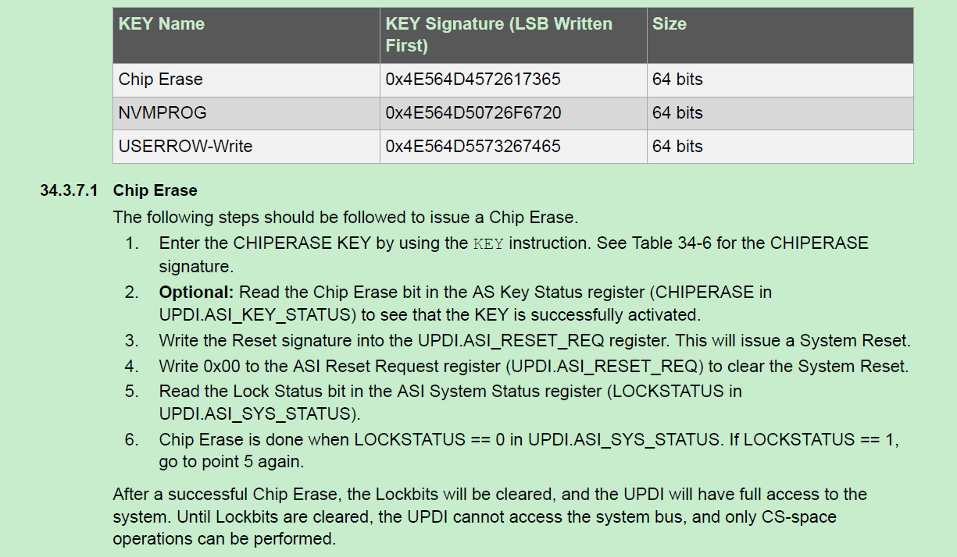
Chip Erase

Slide 8
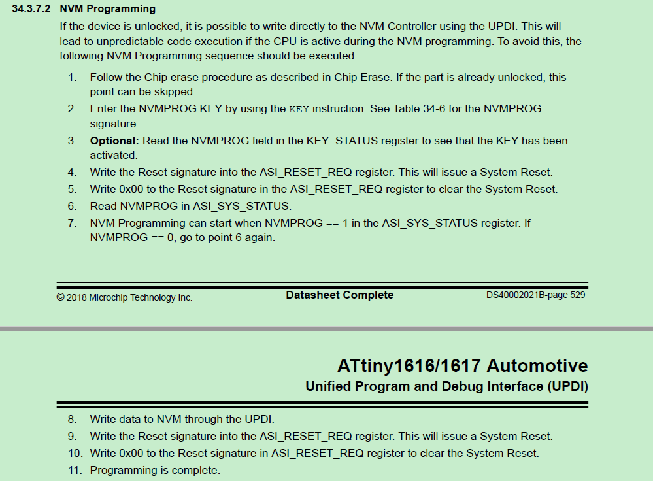
Chip Program

Slide 9
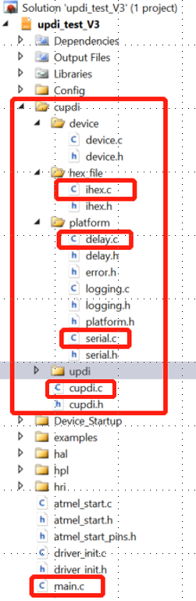
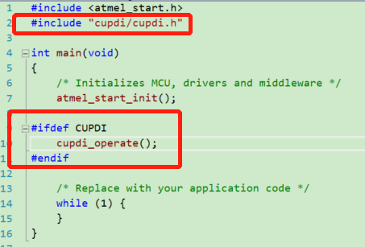
File importing
Copy folder cupdi to your MCU project.
2. Only 5 files need to be modified base on the timer and usart of your MCU.
3. cupdi.h contains the function cupdi_operate() that you need to invoke
to program the Attiny series devices in the main() function or other places.

Slide 10
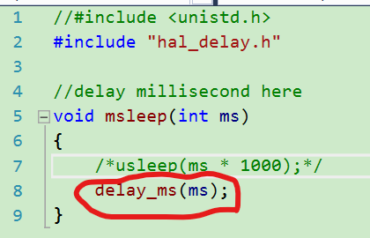
File modifying – delay.c
A millisecond delay function need to be implemented.
You need to replace the function delay_ms with your MCU
implementation.

Slide 11
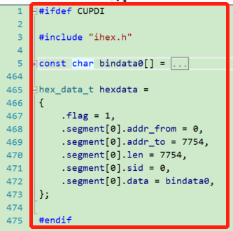
File modifying – ihex.c
Hex file that used to be programmed to the attiny
series devices need to be transferred to bin array.
2. The little tool hex2array.exe can be used to generate
bin array. You can use the tool as below and then you
should copy all the content from the test.c to replace
all the content on the right hand in the ihex.c.
hex2array.exe

Slide 12
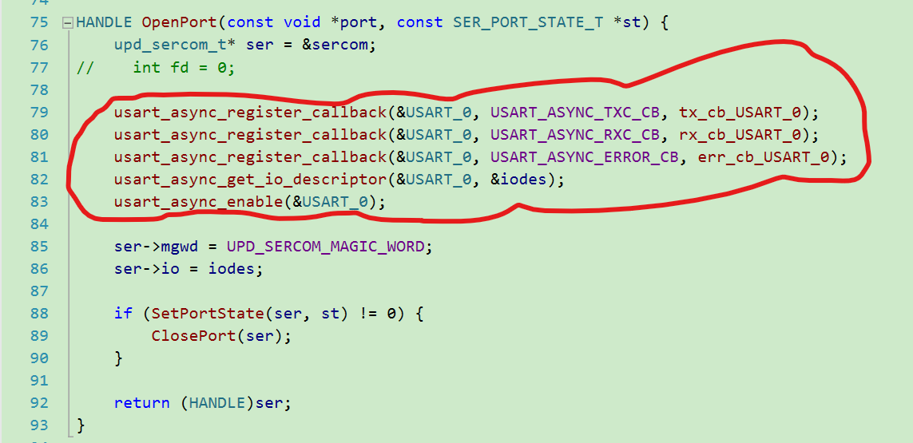
File modifying – serial.c
Call the function based on your MCU to initialize and enable the usart.
2. If the initialization has been done in other place, you don’t need to initialize again.

Slide 13
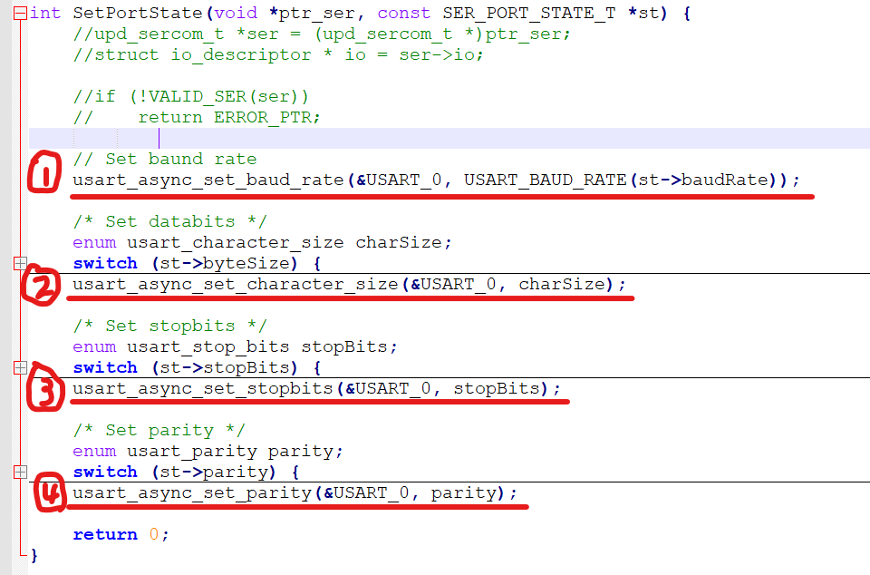
File modifying – serial.c
You need to call the set baud rate function
with your MCU USART function to replace
usart_async_set_baud_rate.
You need to call the set character size
function with your MCU USART function
to replace usart_async_set_character_size.
3. You need to call the set stop bits function
with your MCU USART function to replace
to replace usart_async_set_stopbits.
4. You need to call the set parity function
with your MCU USART function to replace
to replace usart_async_set_parity.
Please be noted the parameters should
be modified according to your MCU.

Slide 14
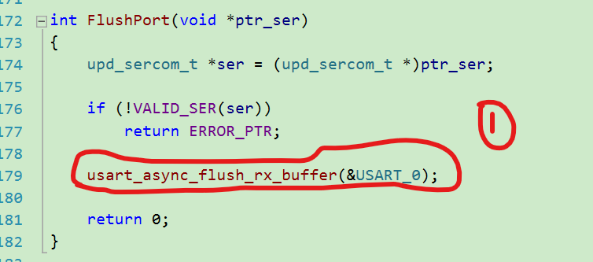
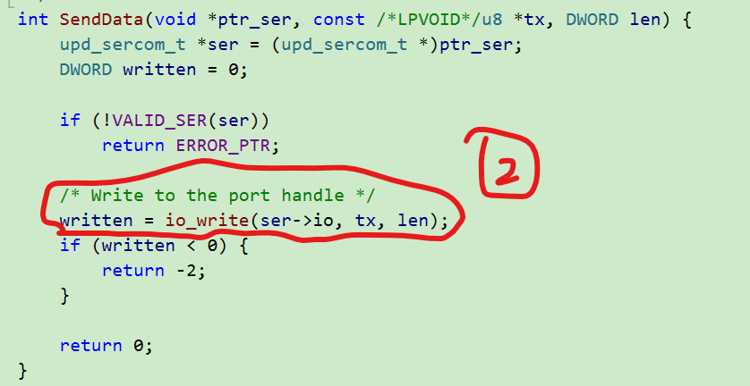
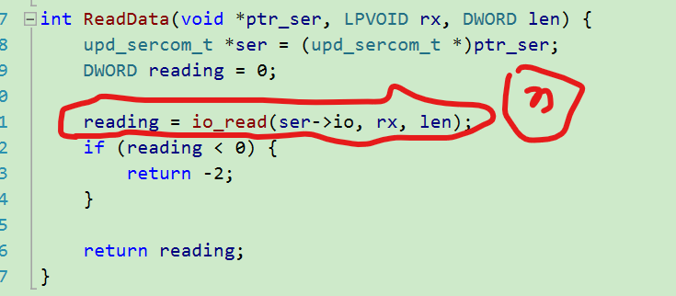
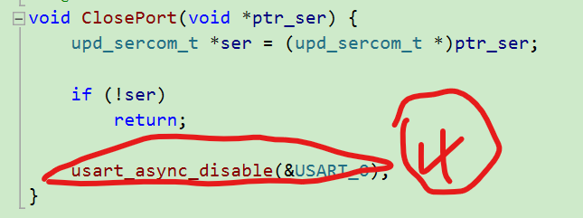
File modifying – serial.c
Please be
noted the
parameters
should
be modified
according to
your MCU.
Call the disable USART
function in your MCU to
replace
usart_async_disable.
Call the flush function in your MCU to replace
usart_async_flush_rx_buffer. 3. Call the usart send function in your MCU
2. Call the usart send function in your MCU to replace io_write. to replace io_read.

Slide 15
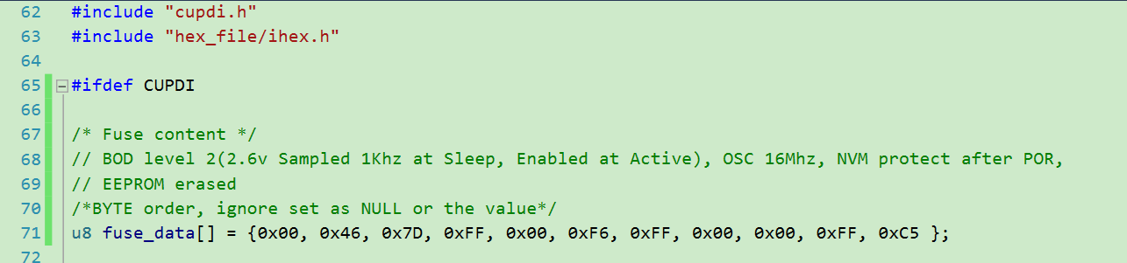
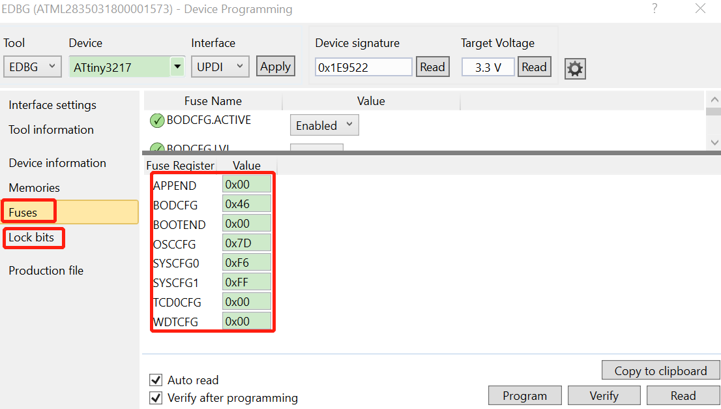
File modifying – cupdi.c
You should read the default fuse data including Fuses and Lock bits through UPDI using data programming of Atmel Studio.
2. If there’re no changes to fuses, then you can copy the fuse data to the array fuse_data[].
3. If you want to change fuses, then you can modify the copied fuse data in the array fuse_data[].

Slide 16
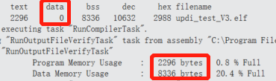
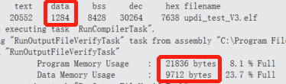
CUPDI size
You need to define the macro CUPDI globally first.
The program memory usage of cupdi is about
20K bytes.
3. The data memory usage of cupid is about
1K bytes.
4. The bin array transferred from hex file can be allocated
in program memory or data memory based on your
MCU memory. And the size is less than the flash size of
Tiny series devices.
Undefine CUPDI
Define CUPDI

